Slide 1


April 7th, 2015

Slide 2

TNC Global has established a strong reputation in the Cleaning and Sanitation market in Australia and New Zealand.
Australia represents the bulk (2 thirds) of USD$125m Cleaning and Sanitation market
◦ we estimate the total market to be approximately USD$150m by 2018.
The growth of the Cleaning and Sanitation market has performed in line with the rate of CPI of circa 3.5% in recent years.
The Cleaning and Sanitation market is supplied by commodity and specialty ◦ commodity based chemicals ~30%
◦ formulated chemical ~70%
Government legislation and regulatory standards from food safety authorities drive and ensure compliance for export companies.

Slide 3
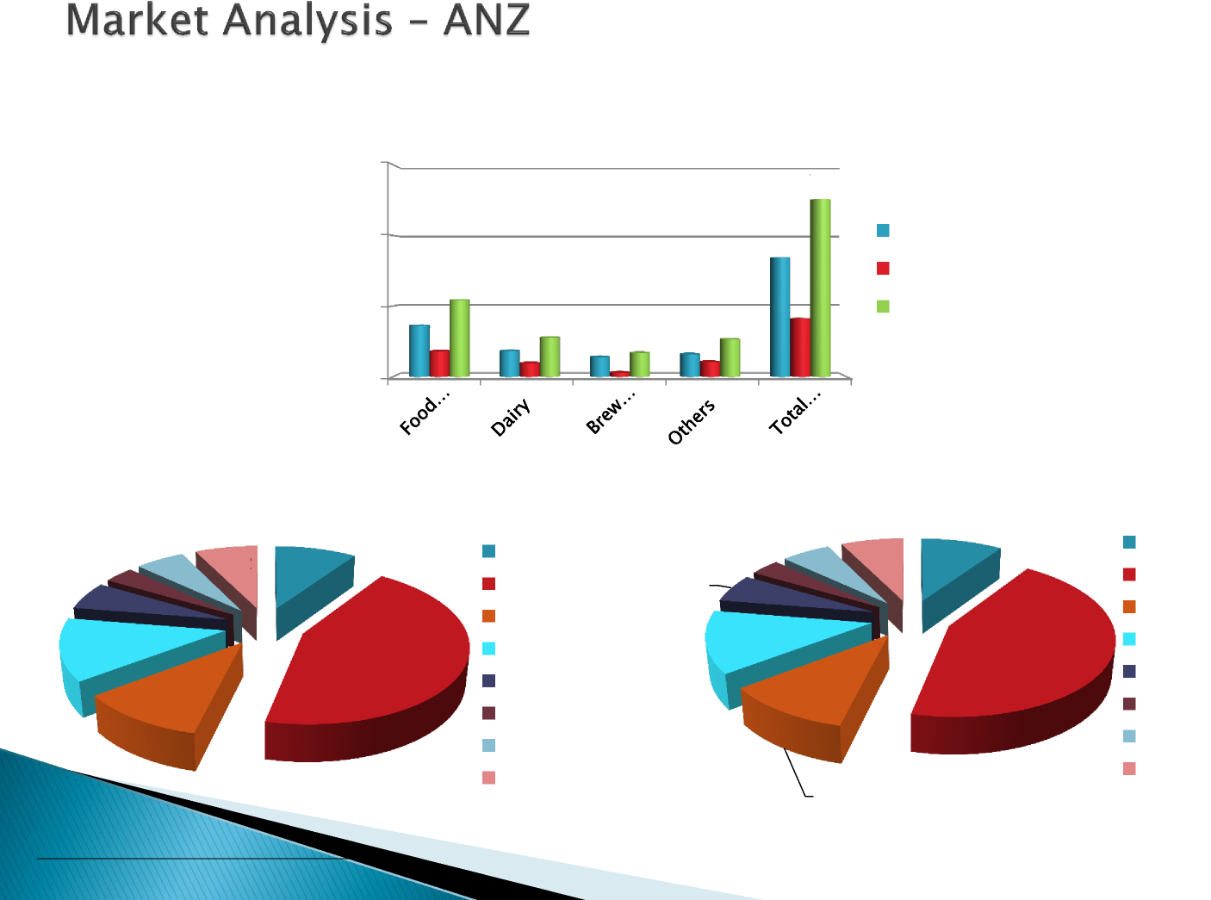
Total ANZ $ Value Market Segment USD 125 million
150.0
126
100.0
85
AU NZ ANZ
54
41
50.0
36
28
27
18 18 14 16
17
10 3 11
0.0
Market Share F&B ANZ USD 125 million
Market Share F&B competitor %
5.7%
7.3%
JD 2008 EL
Orica
CB
Jasol
AC Sopura Others
4.4
7.2
JD 2008 EL
Orica
CB
Jasol
AC Sopura Others
3.5%
9.5%
7.4
9.2
12.0
5.9%
16.3
13.0%
55.5
44.2%
13.7
10.9%
Source: Kuffel-Reyno, IBIS, market intellig

Slide 4
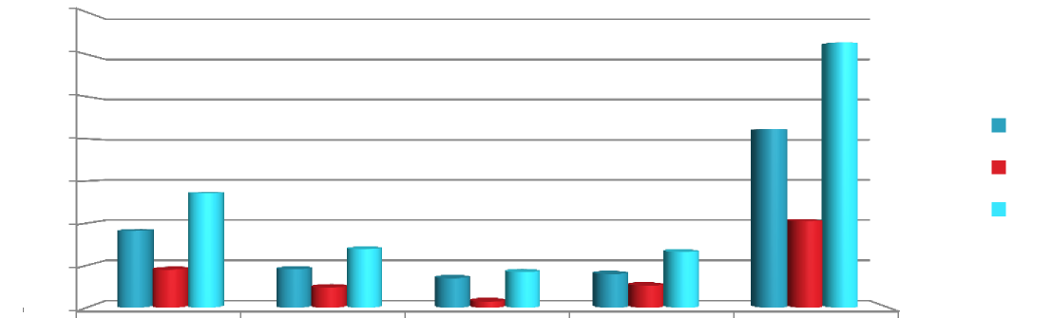
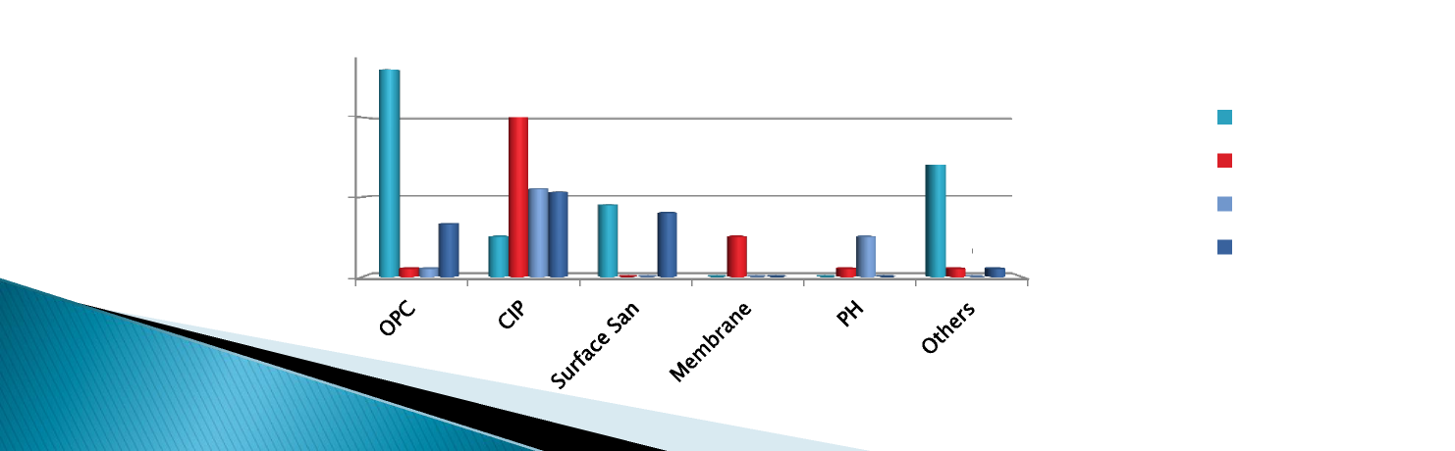
ANZ F&B Market Segmentation $ Value (USD million)
140.0
126
120.0
100.0
85
80.0
AU NZ ANZ
60.0
54
36
41
40.0
28
27
18 18 14 16
17
10 3 11
20.0
0.0
Food Dairy Brewing and Others ANZ Total
Processing Beverage Market
ANZ F&B Application Segmentation $ Value (USD million)
26
20
20.0
Food Processing Dairy
Brewing and Beverage Others
14
11
9
10.0
7
8
5
11
5
5
1
1
0 0 0
0 0
1
0 0
1
0
1
0.0
Source: Kuffel-Reyno, IBIS, market intellig

Slide 5
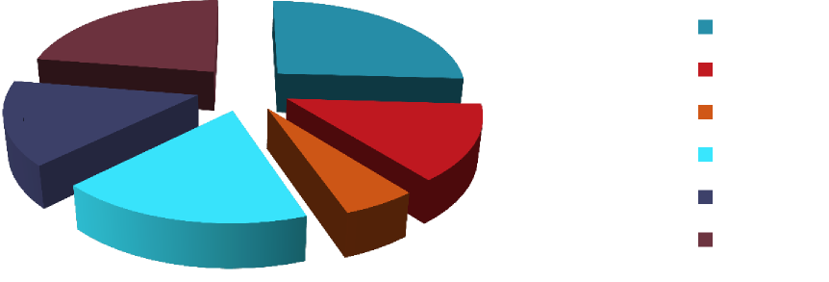

TNC Global Sector representation in ANZ %
12.5%
14.4%
OPC
CIP
Surface San Membrane PH
Others
8.3%
7.5%
10.0%
2.9%
TNC Global Sector ANZ % place segmentation
Food Processing
Dairy
Brewing and Beverage Others
JD in ANZ Total Market
9.5%
16.8%
0.5%
4.1%
7.2%
Source: Kuffel-Reyno, IBIS, market intellig

Slide 6
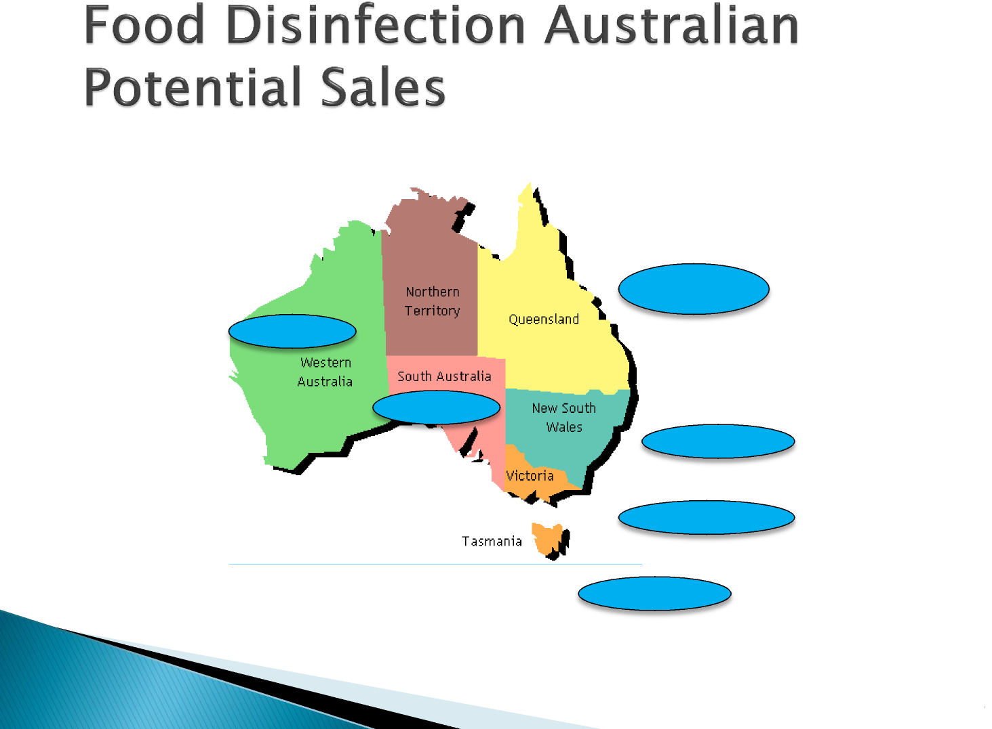
1,135
>2
0,62
2,405
6,818
>1
Source: Kuffel-Reyno, IBIS, market intellig
8

Slide 7
This is the biggest segment and is highly fragmented between meat, poultry, vegetable processing, cereals, bakery, and snack foods.
Key accounts in ANZ are:
Simplot/Top Cut Meats, Campbells Arnotts, Primo,
Inghams, Sara Lee
Red Meat
JB Swift, AMH, Silver Fern Farms, Burns Philip, CMP, SPM,
Alliance
ANZCO
Processing plants are concentrated in three major states of NSW, Victoria, Queensland and NZ Sth Island making up more than 70% of the total market.
Compliance to legislation and industry standards are key drivers for this segment. It is a minimum to supply and compete globally, as 80% of the aggregate products produced are exported.

Slide 8
The dairy industry is the biggest food exporter throughout ANZ, with
the largest milk processor being the Fonterra group (formed in 2001),
processing 75% of the total milk.
Key accounts in ANZ that account est. 90% of the sector are:
◦ Fonterra , Parmalat, GOI, Richmond Dairies, Brownes Dairy
◦ Murray Goulburn, National Foods-Kirin (inc. Dairy Farmers) , Nestle
Liquid Milk processing represents circa 80-90% of total dairy
production.
◦ CIP demand comprises about 75%
◦ Membrane cleaning demand comprises 15%
The chemical and sanitation market is mostly dominated by Ecolab.
◦ value added bundle of products and technologies positioned as a
one stop for agriculture and dairy farmers
Compliance to legislation and industry standards are key drivers for this
segment.

Slide 9

Relative market share involving Brewing and Wine production sees
Australia at 80% and New Zealand 20%. Brewing represents 65% with
Wine representing 35%
Key accounts (i.e. 90% market share) in ANZ are
◦ SAB Miller and Kirin production in Aus
◦ DB Breweries / Heineken production in NZ
DB Breweries prefer high value products to meet their sanitation
standards.
◦ i.e. DB only buys products that have been certified by Heineken HQ.
Compliance to legislation and industry standards are key drivers for this
segment.
segment.
Source: Kuffel-Reyno, IBIS, market intellig
Source: Kuffel-Reyno, IBIS, market intellig

Slide 10
The soft drink segment is growing moderately through:
◦ blended sports drinks and bottled water
◦ preference for healthy drinks include functional drinks, fruit
juice
Key Accounts include Coca Cola @ 65%, Schweppes who
represent est. 90% of the ANZ market.
Non alcoholic production Cleaning and Sanitation demand comprises:
◦ CIP ~ 60%
◦ Track Treatment ~ 25%
◦ OPC ~ 15%
Compliance to legislation and industry standards are key drivers for this
segment.
Source: Kuffel-Reyno, IBIS, market intellig

Slide 11

Target the ANZ Food and Beverage
business by leveraging existing business
relationships in Brewing, Beverage and
Dairy sectors while consolidating our
presence in Food Processing and Dairy
sectors in C&S.
segment.
Source: Kuffel-Reyno, IBIS, market intellig

Slide 12
Develop comprehensive business plan
Deliver profitable sales to budget est USD $300k in 2015
Develop sales funnel to deliver est USD$1.1m for 2016
Expand product range to support business growth i.e. Premium and Economical OPC offering, Expand Dairy product range to NZ etc
Continued core sales force technical competency development
Expanding and standardise a value added delivery program for our customers using Electronic Reporting
Develop ANZ Sales Team

